Slide 1


Evaluating Large Language Models Medicine
Chris KAMBIMBI (卡穆), Fudan University

Slide 2
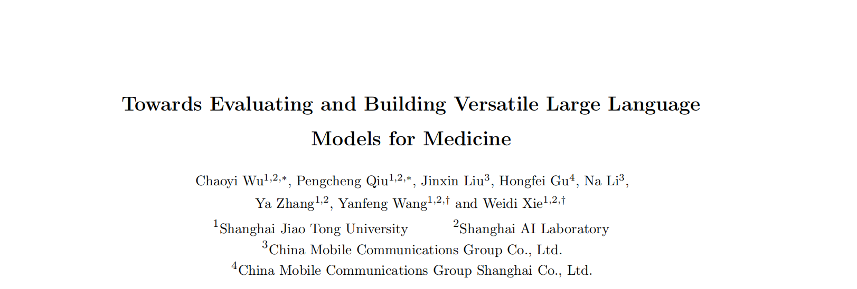
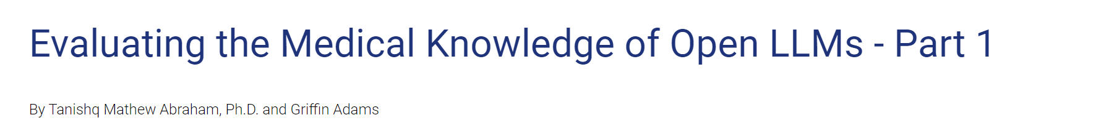
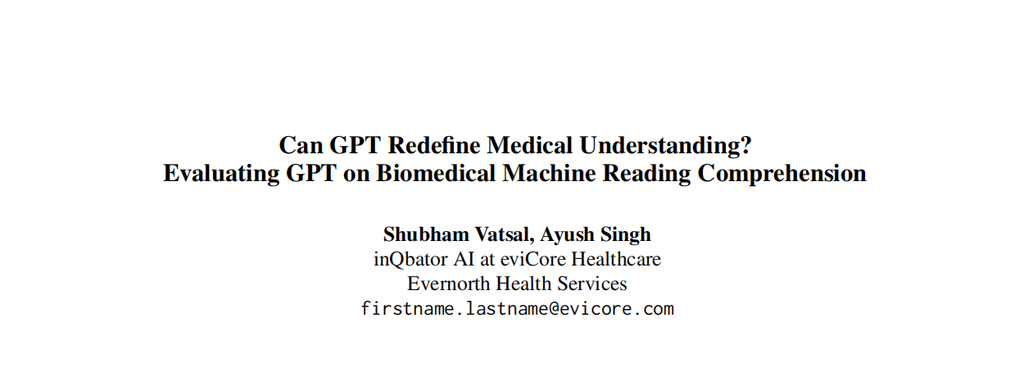
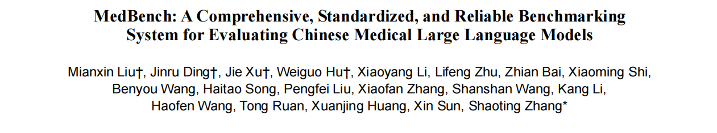
papers

Slide 3

Contents
1. Medicine in LLM
2. Evaluating LLMs for Medicine
3. Methods
4. Results

Slide 4
Medicine in LLM
Medicine in LLM
Landscape of LLMs
Medicine LLMs
LLM Applications

Slide 5
Medicine in LLM
LLMs have been successfully applied to a diverse set of tasks, ranging from coding assistants to robotics. One area of keen interest is healthcare, where LLMs have the potential to assist care providers with administrative workflows and to provide clinical decision support.
As such, there has been significant research in the past few years related to both understanding the medical capabilities of LLMs, as well as developing LLMs trained on medical text.
Generalist LLMs like GPT-4 and PaLM exhibit medical knowledge that can be elicited via prompt engineering or minimal finetuning.
Training of medical domain-specific LLMs has also shown significant promise and it is an open question which approach is superior.
Hence evaluations.
Notes:
做一个简单的引入

Slide 6
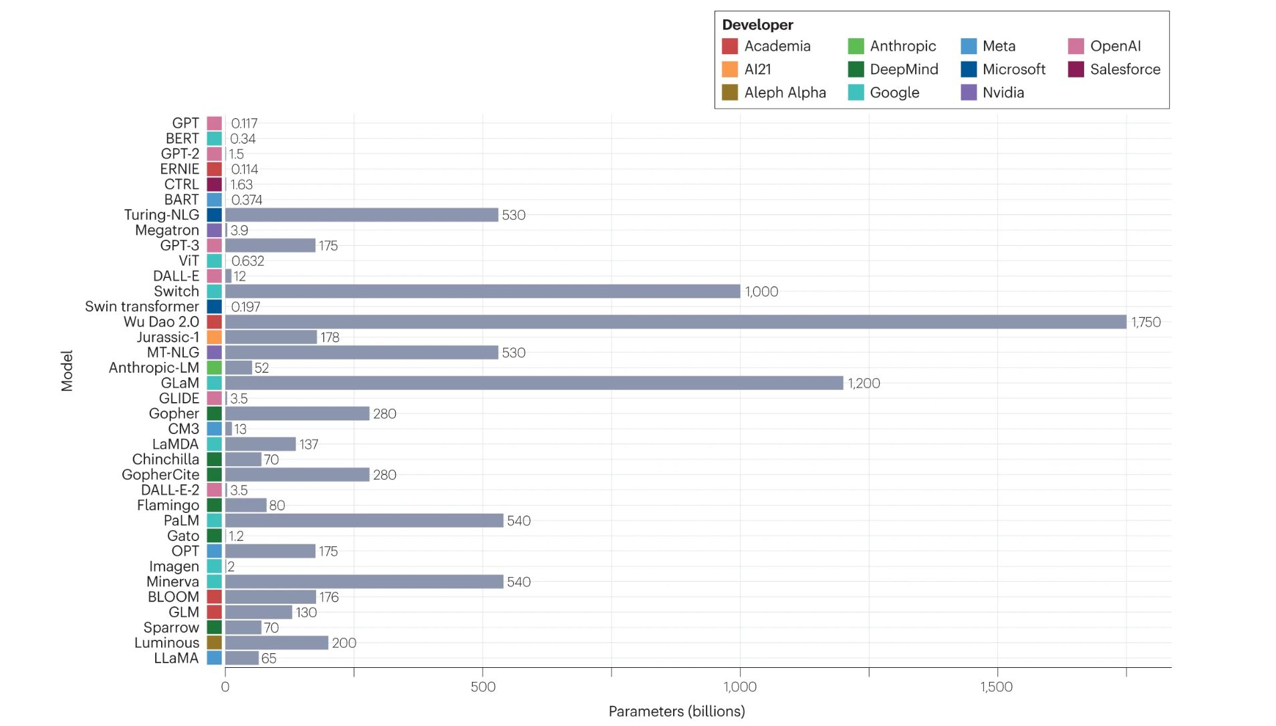
Landscape of LLMs
Large language models in medicine, https://www.nature.com/articles/s41591-023-02448-8?fromPaywallRec=false

Slide 7
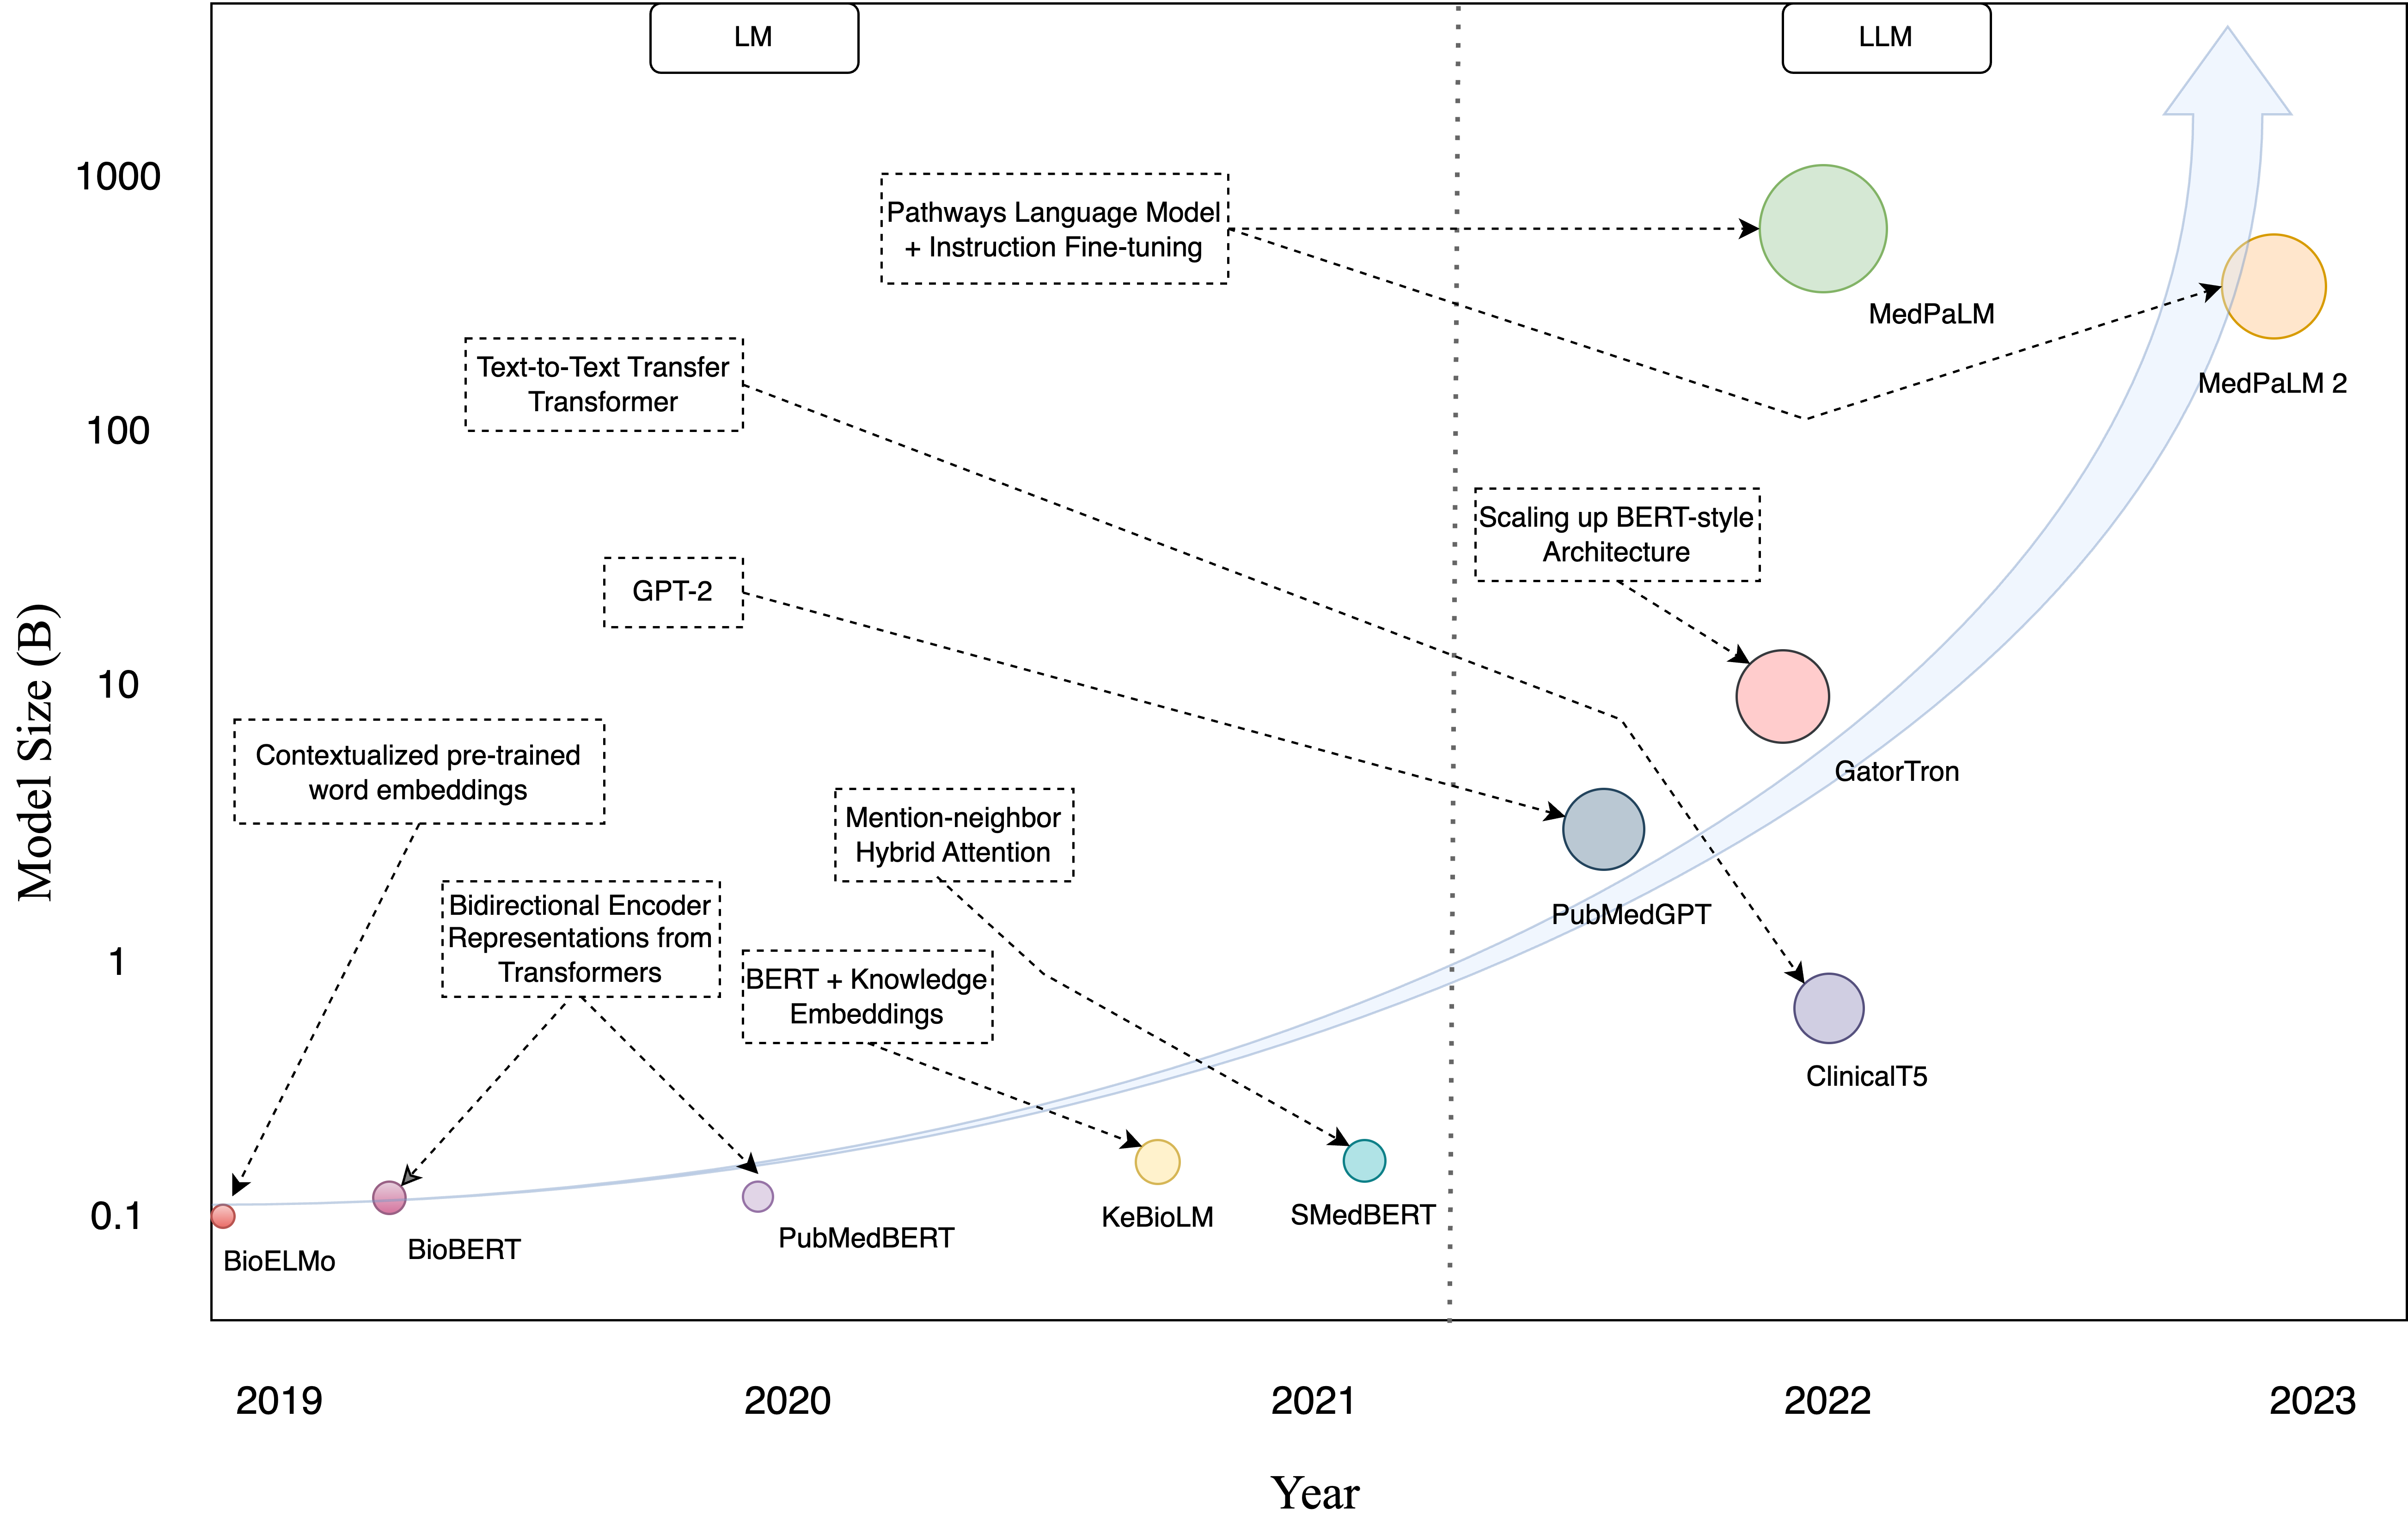
LLMs in medicine
Large Language Models in Healthcare and Medical Domain: A Review, https://arxiv.org/html/2401.06775v2

Slide 8
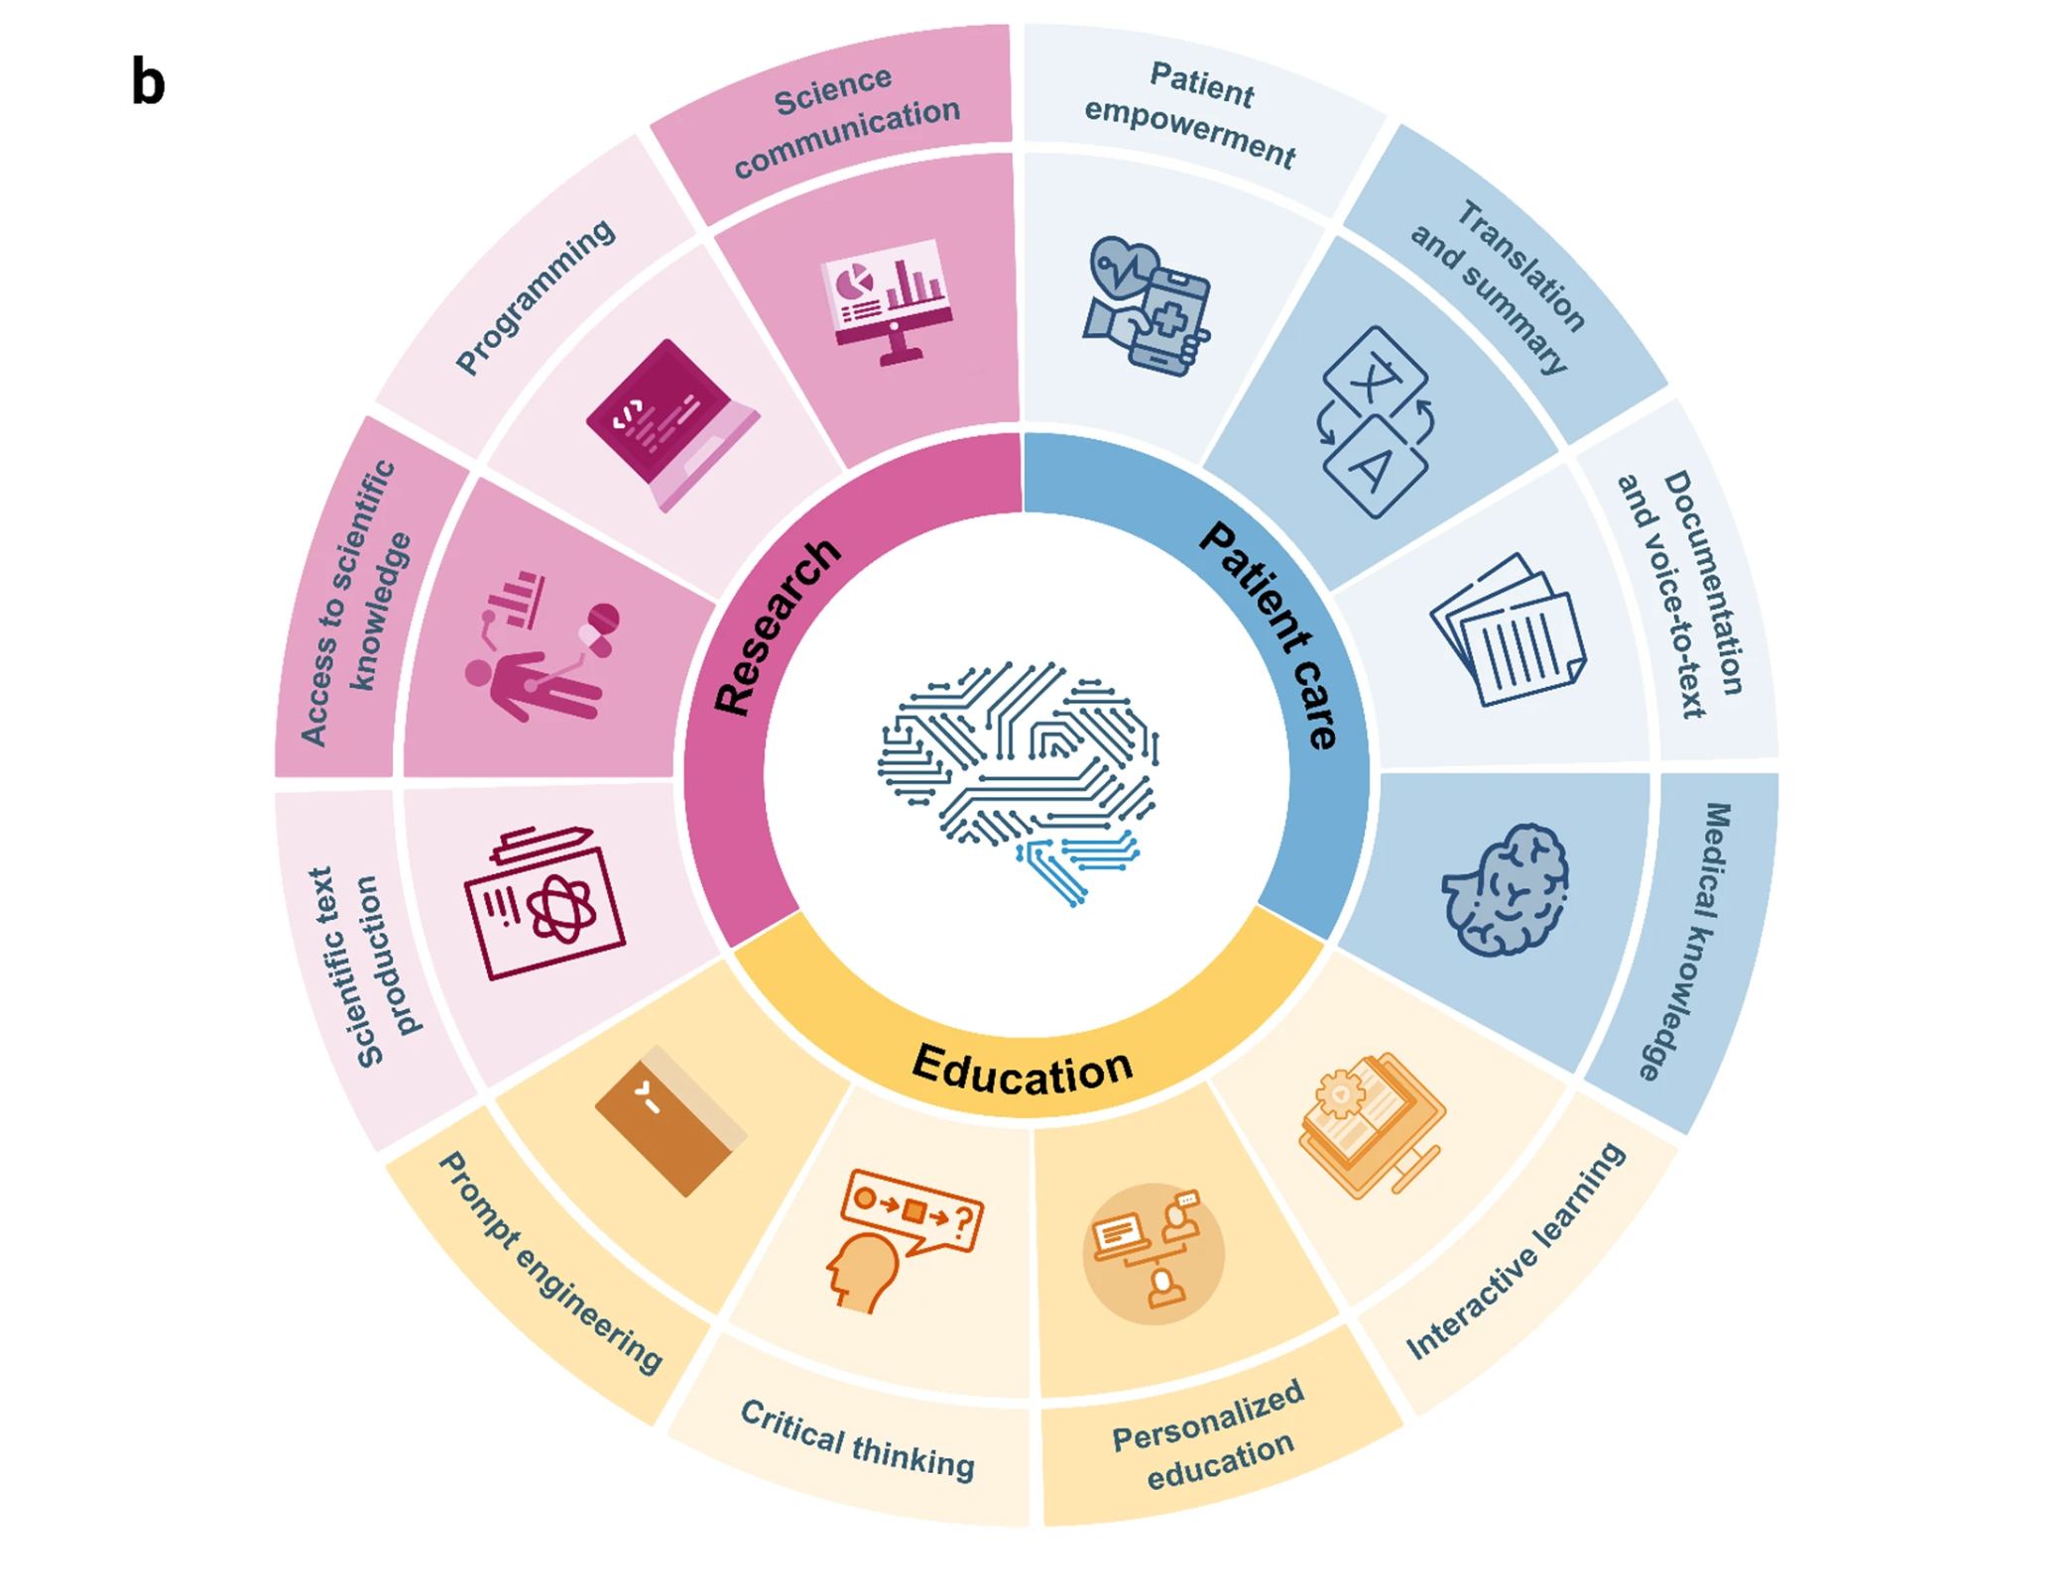
LLM Applications
The future landscape of large language models in medicine, https://www.nature.com/articles/s43856-023-00370-1

Slide 9
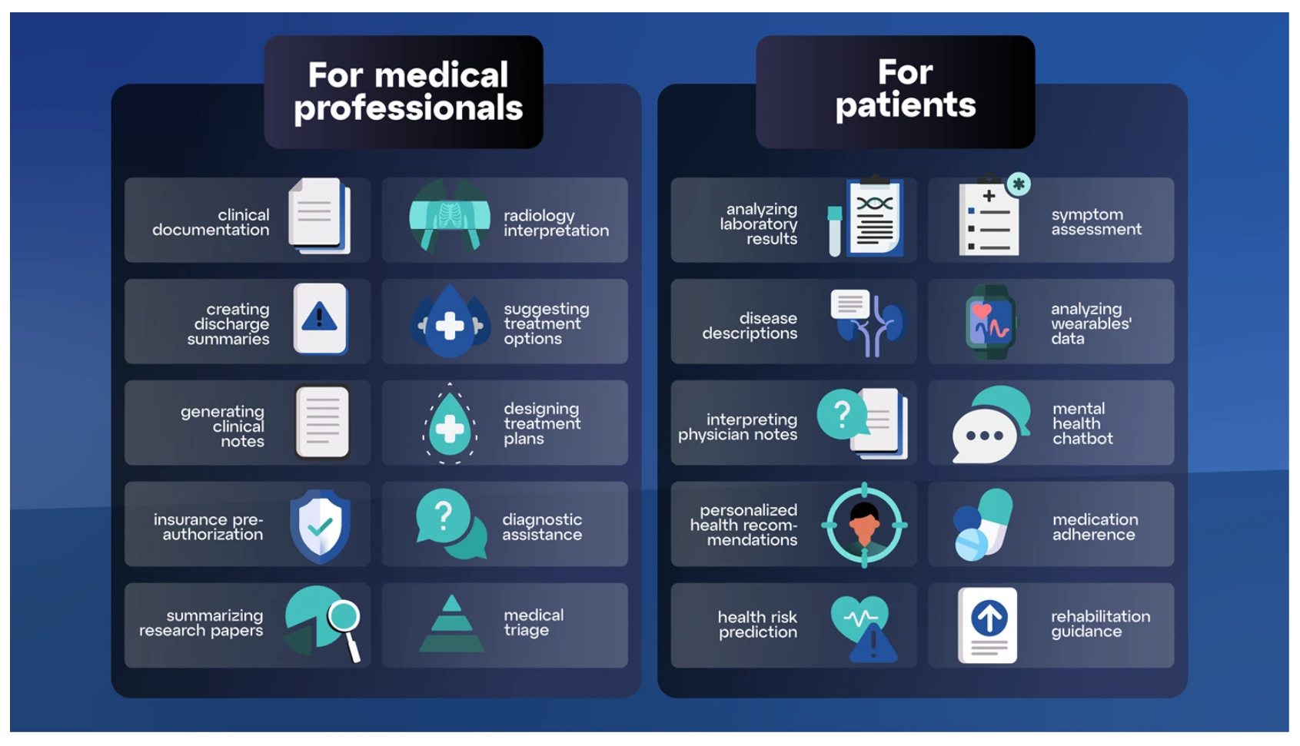
more applications
The imperative for regulatory oversight of large language models (or generative AI) in healthcare, https://www.nature.com/articles/s41746-023-00873-0

Slide 10
Evaluating LLMs for Medicine
References
MultiMedQA
MedS-Bench
MedS-Ins
Tasks

Slide 11
References

Slide 12
Contributions
Towards Evaluating and Building Versatile Large Language Models for Medicine
Unlike existing benchmarks that focus on multiple-choice question answering, MedS-Bench spans 11 high-level clinical tasks, including clinical report summarization, treatment recommendations, diagnosis, named entity recognition, and medical concept explanation.
Can GPT Redefine Medical Understanding? Evaluating GPT on Biomedical Machine Reading Comprehension
To solve some of the retrieval problems inherent to LLMs,
Evaluate different prompting techniques with GPT on four closed-book biomedical MRC benchmarks.
MedBench: A Comprehensive, Standardized, and Reliable Benchmarking System for Evaluating Chinese Medical Large Language Models
MedBench, a pioneering benchmarking system
tailored specifically for evaluating Chinese MLLMs
Evaluating the Medical Knowledge of Open LLMs
evaluate a variety of SOTA generalist open LLMs (Llama-2, Mistral, Yi, etc.) on MultiMedQA to see how well they stack up against proprietary LLMs.

Slide 13
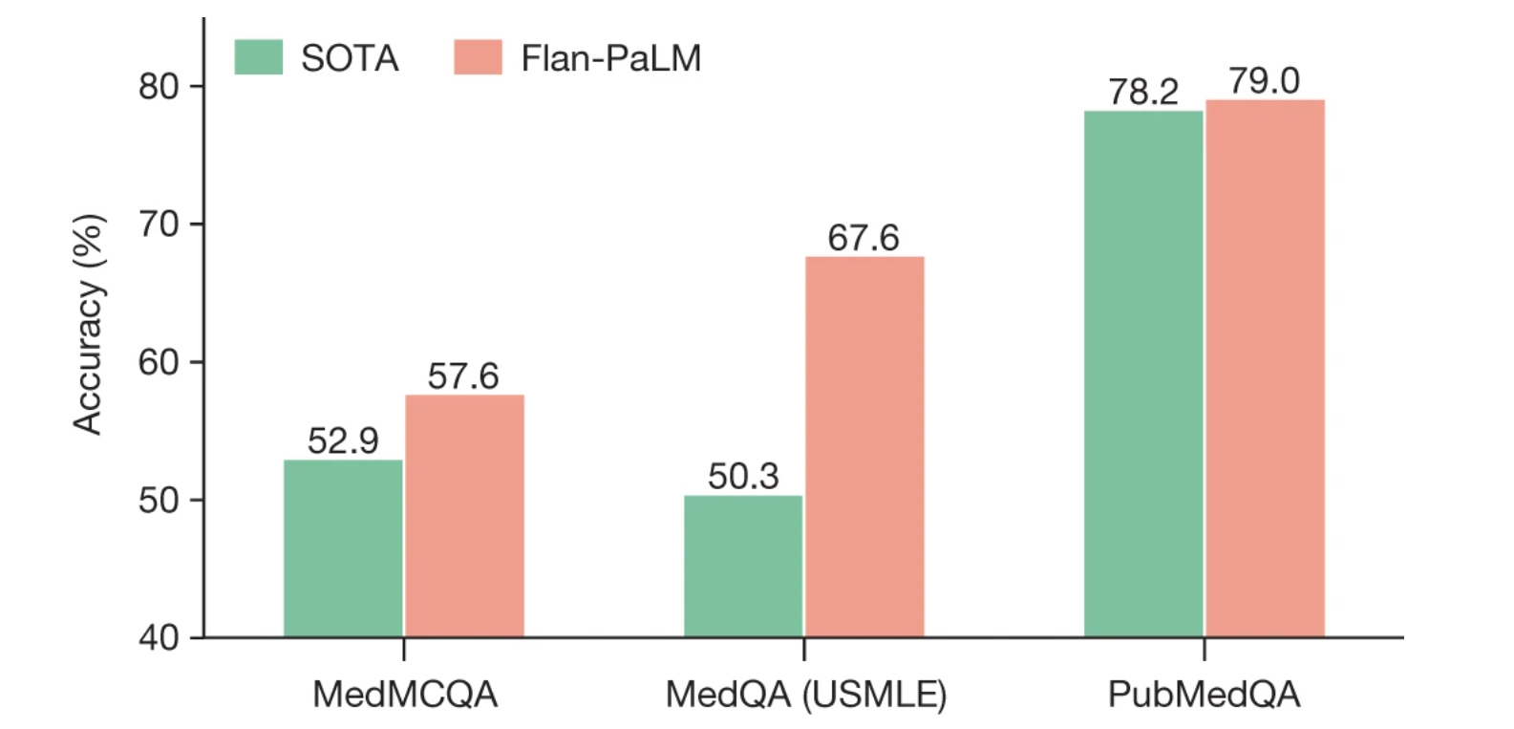
MultiMedQA
A suite of medical multiple-choice question-answering tasks introduced by Google in the Med-PaLM paper. MultiMedQA includes tasks like
PubMedQA: 1,000 expert-labeled Q&A pairs where a question and corresponding PubMed abstract as context is given, and a yes/maybe/no answer must be produced.
MedQA: US Medical License Exam (USMLE) questions with 4 or 5 possible answers
MedMCQA: 4-option multiple choice questions from Indian medical entrance examinations, >191k total questions
MMLU: 4-option multiple choice exam questions from;
Anatomy
Clinical Knowledge
College Medicine
Medical Genetics
Professional Medicine
College Biology
Large language models encode clinical knowledge, https://www.nature.com/articles/s41586-023-06291-2

Slide 14
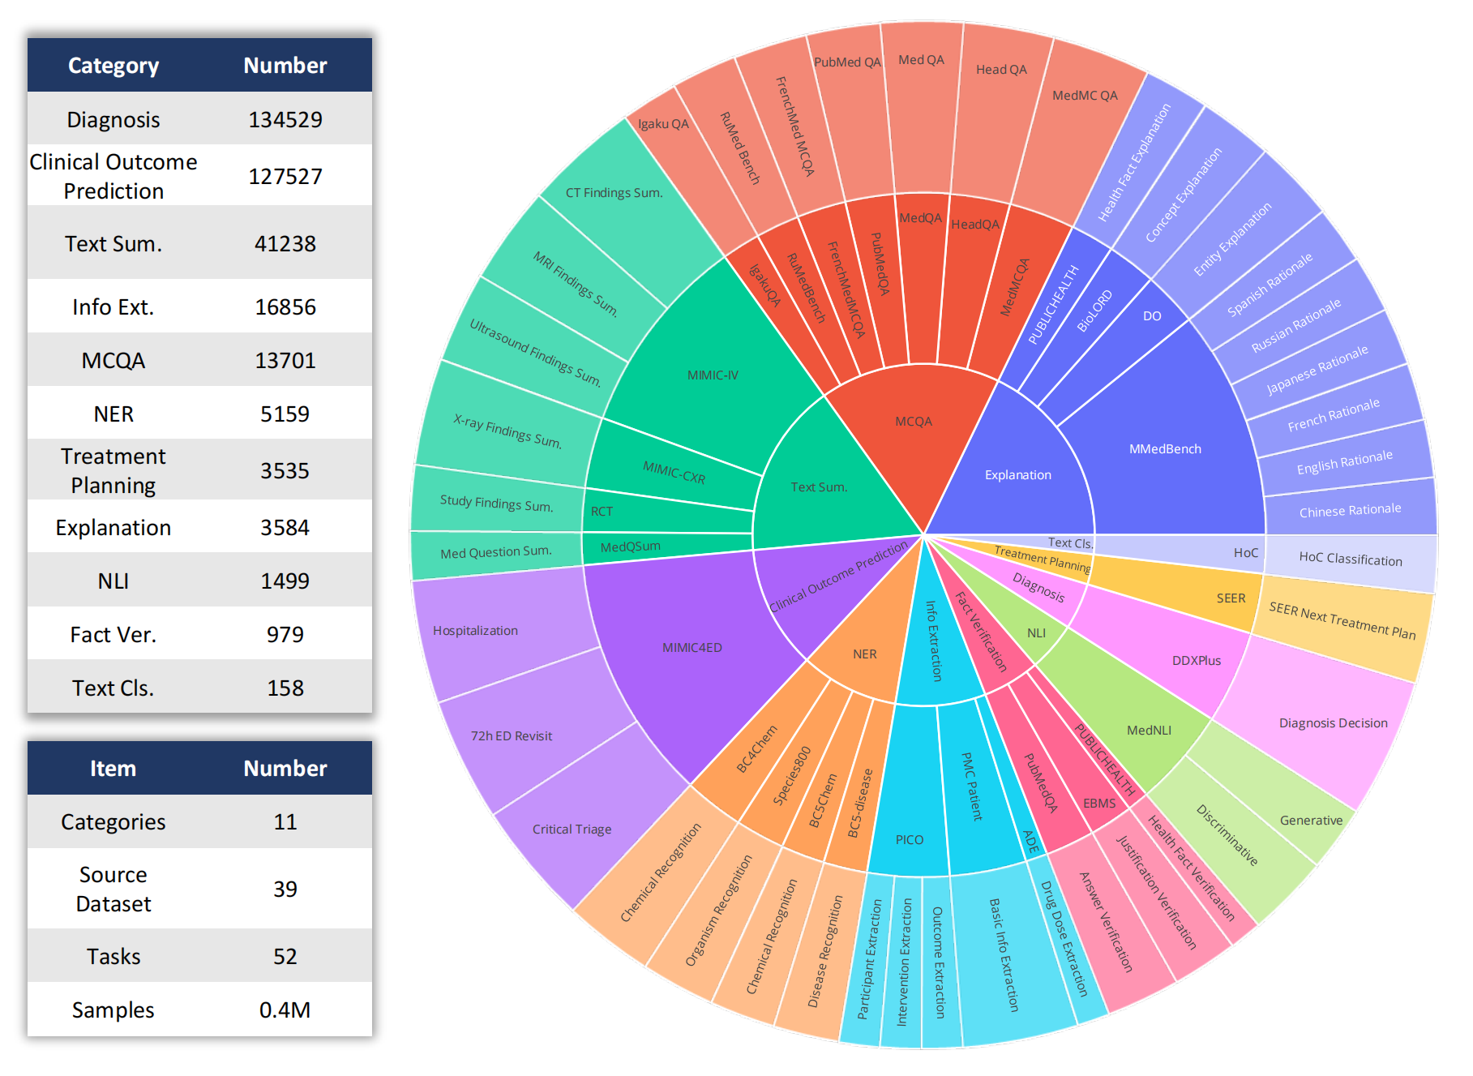
MedS-Bench
benchmark employed in our study, designed to provide a comprehensive evaluation across a range of tasks critical to clinical applications.
hierarchical ring chart displays the data distribution within the evaluation benchmarks
The first tier categorizes the 11 types of tasks
second tier outlines the 39 datasets involved
The third tier details the 52 specific tasks
Benchmark Statistics

Slide 15
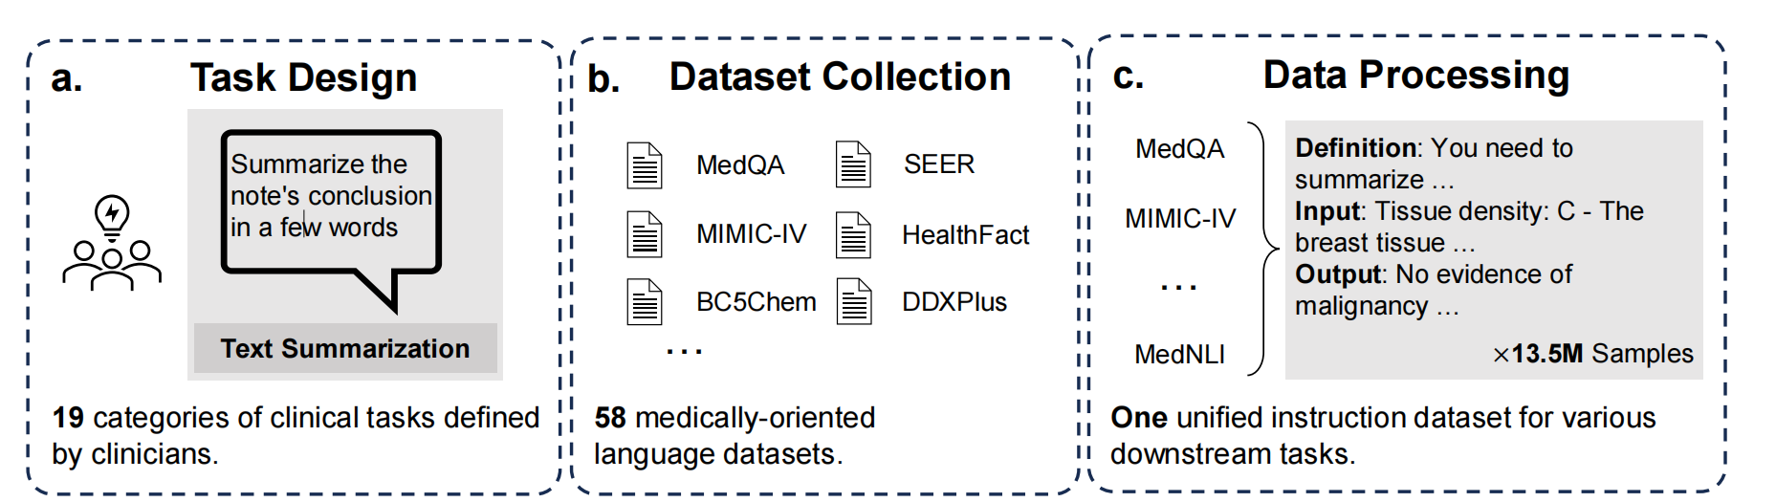
MedS-Ins
a large-scale instruction tuning dataset for medicine. MedS-Ins comprises 58 medically oriented language corpora, totaling 13.5 million samples across 122 tasks.
a. The task collection pipeline b. Collect the existing 58 public datasets. c. Convert the formats of different datasets into one unified medical instruction dataset

Slide 16
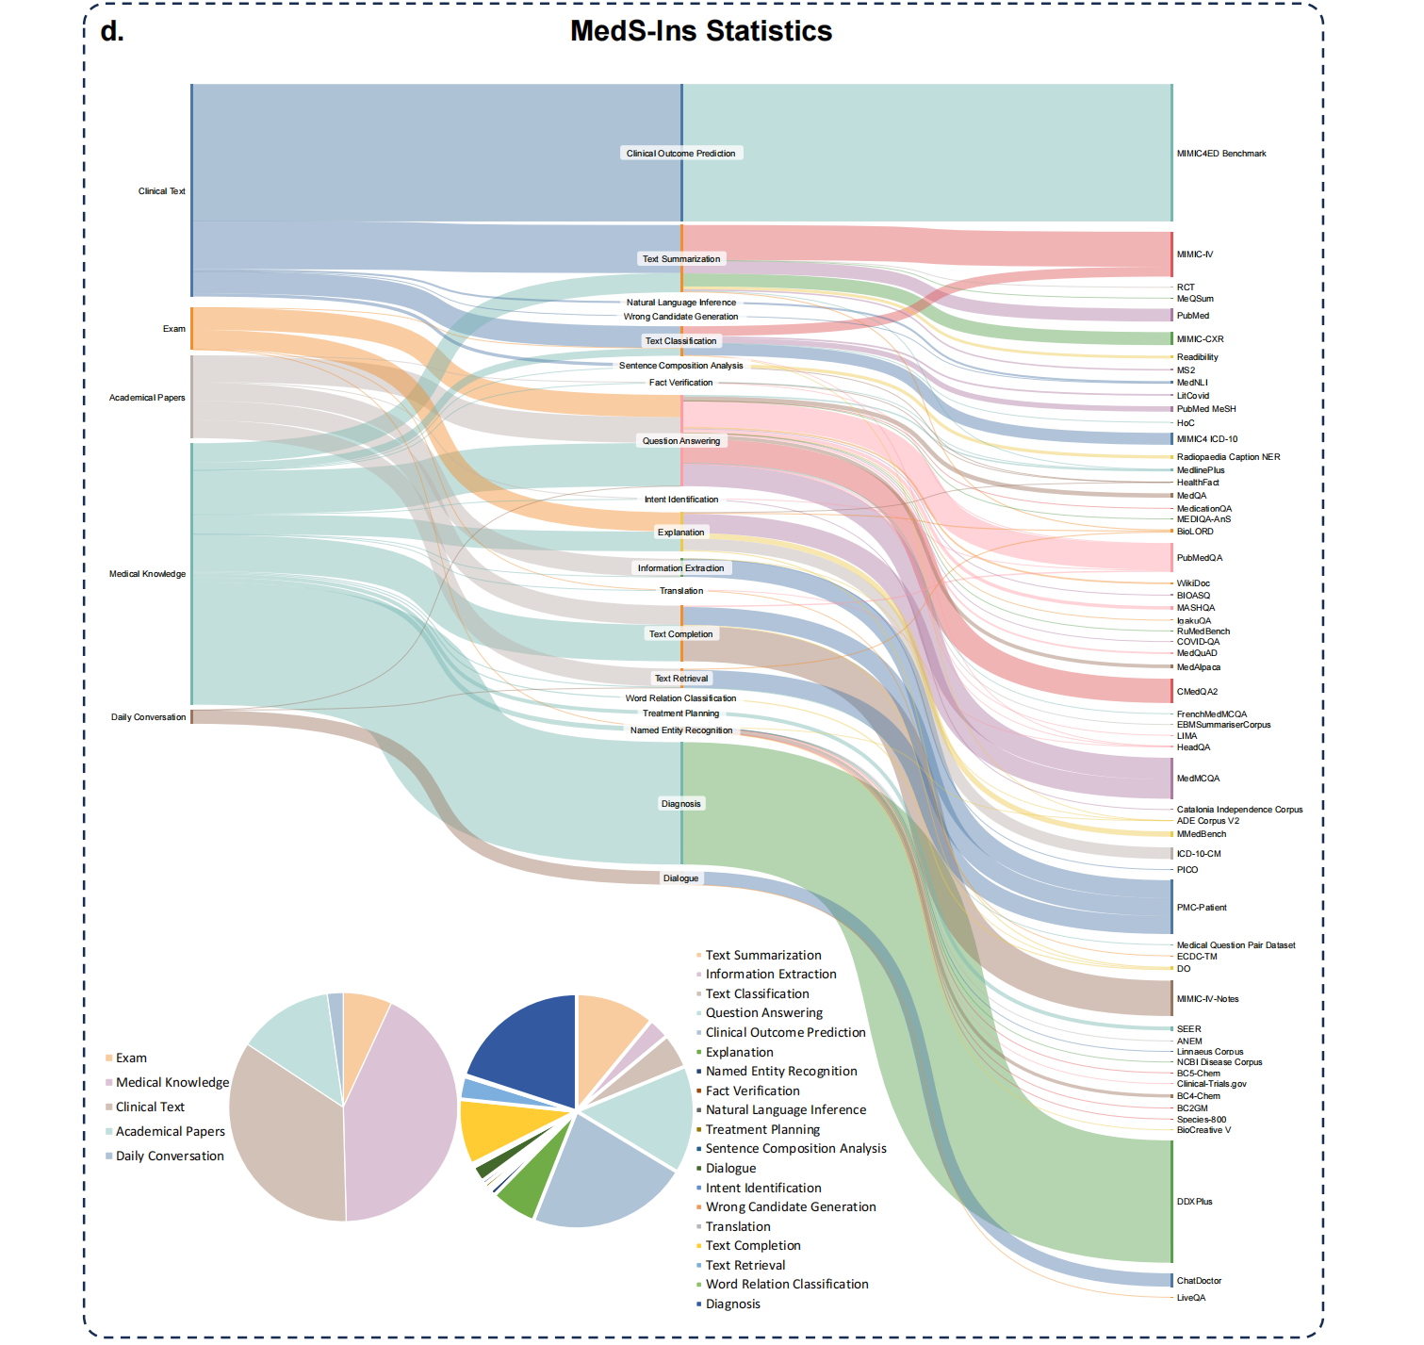
d. The final data distribution of
our collected MedS-Ins.

Slide 17
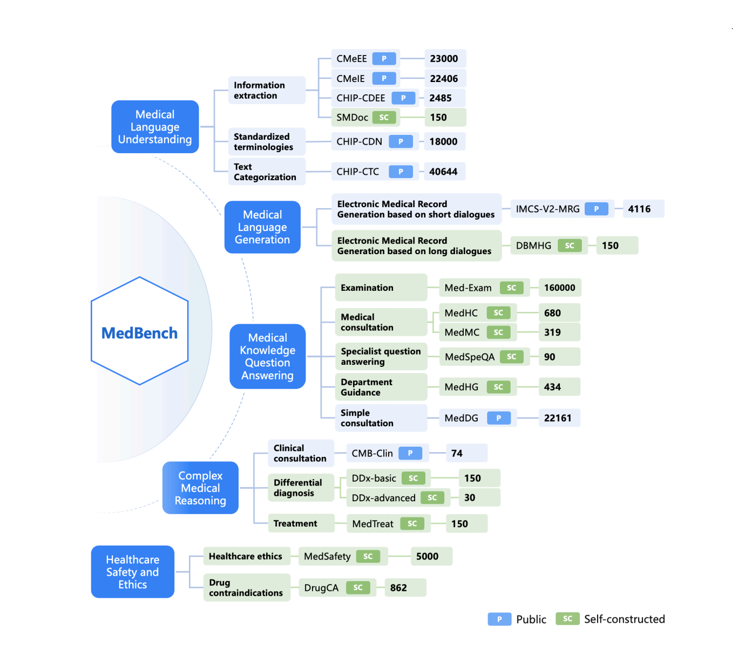
MedBench
comprehensive, standardized, and reliable benchmarking system for Chinese medical LLM.
MedBench assembles the currently largest evaluation dataset
(300,901 questions)43 clinical specialties and performs multi-facet evaluation on medical LLM.
Second, MedBench provides a standardized and fully automatic cloud-based evaluation infrastructure,
Third, MedBench implements dynamic evaluation mechanisms to prevent shortcut learning and answer remembering
The distributions and the measuring dimensions of the datasets in MedBench

Slide 18
Tasks
Retrieval & Screening: including document retrieval, article representation, and sentence representation. Q. Jin et al
Modeling & Analysis: fraction of valid and unique molecules, fragment similarity, and similarity to the nearest neighbor, among others. H. Li et al
Writing & Reference Generation: explore its capability in generating fraudulent scientific articles in the medical field, specifically in neurosurgery. M. Májovskỳ et al
Medical Education: ability to educate medical related knowledge R. Golan et al
Public Awareness Application: utilize ChatGPT(GPT-3.5) to address fertility-related queries. J. Chervenak et al
Closed-ended Tasks: MCQ. Karan Singhal et al
Open-ended Tasks: C. Wu et al
Summarization: LLMs can help summarize medical research evidence. Tang et al.
Information extraction:
Image Processing Tasks:
Image Classification: evaluated the multi-class/multilabel classification performance of LLMs. Royer et al
Report Generation: evaluate the radiology report generation performance. Li et al

Slide 19
Methodology
lm-eval-harness
Evaluation experiment
Method pipeline

Slide 20
lm-eval-harness
Popular library for evaluating language models,
evaluated; 22 models on MultiMedQA. including Llama-2, Yi, Mistral, StableLM, Qwen models, and Meditron-70b, which is one of the best open-source medical LLMs.
Performed both zero-shot and five-shot evaluation for each model.
evaluation approach: for each task, the conditional log likelihood of each answer letter (A, B, C, D) given the document is calculated, and the answer choice with the highest log-likelihood is selected.
In the case of PubMedQA, the length-normalized log-likelihood for the "yes", "no", and "maybe" answer options are compared.

Slide 21
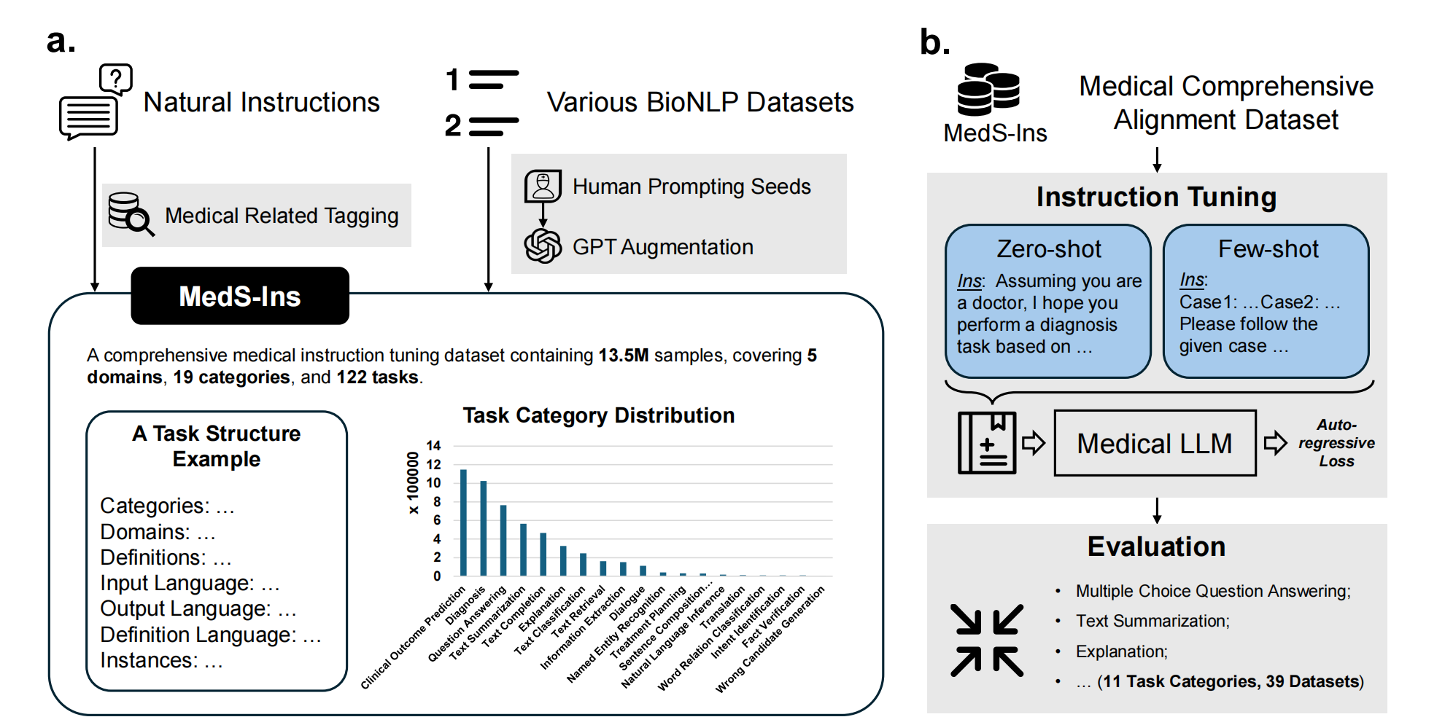
Method pipeline
a. The data collection pipeline. We mainly collect data through filtering natural instructions and prompting well-organized BioNLP datasets.
b. The training and evaluation pipeline for our model leveraging the collected MedS-Ins.

Slide 22
few-shot prompting,
evaluated six leading LLMs, including, MEDITRON, Mistral, InternLM 2, Llama 3, GPT-4, and Claude-3.5 using few-shot prompting
developed MedS-Ins, a large-scale instruction tuning dataset for medicine. MedS-Ins comprises 58 medically oriented language corpora, totaling 13.5 million samples across 122 tasks.

Slide 23
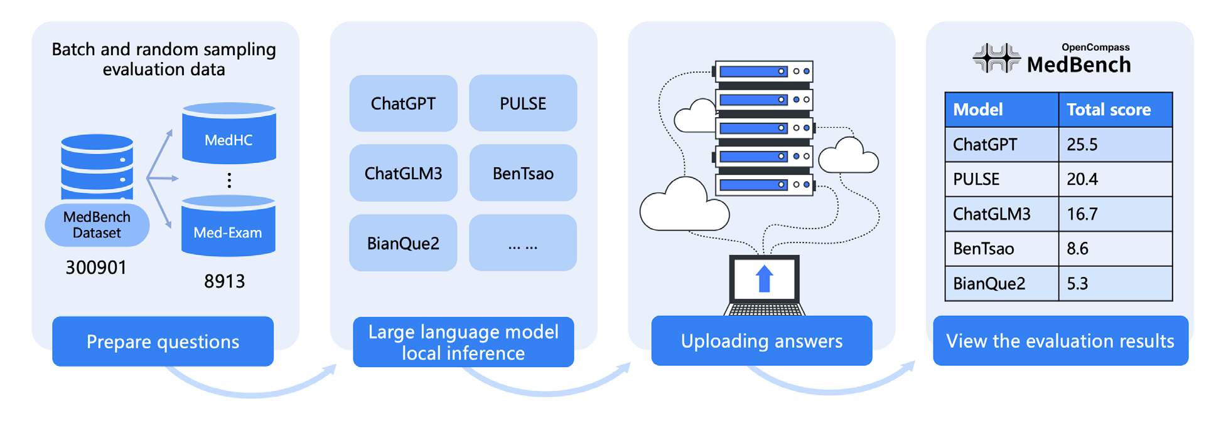
Evaluation experiment
The workflow of the MedBench benchmark platform

Slide 24
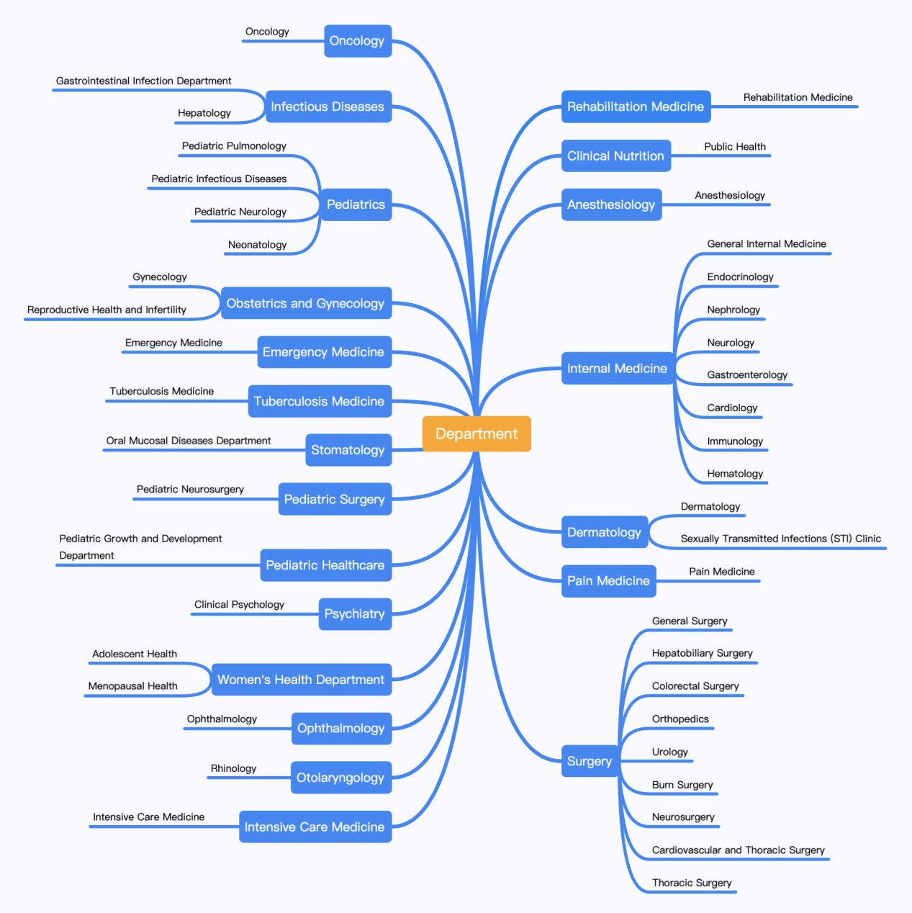
clinical specialties in MedBench

Slide 25
Results
Evaluating the Medical Knowledge of Open LLMs
Towards Evaluating and Building Versatile Large Language Models for Medicine

Slide 26
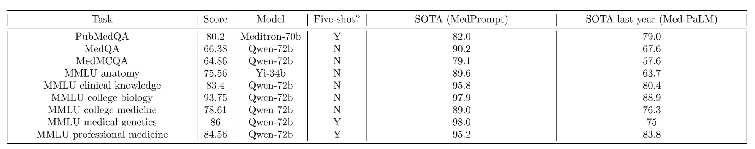
Evaluating the Medical Knowledge of Open LLMs
The below table reports the best score for each task, what model it was, and whether it was zero-shot or five-shot

Slide 27
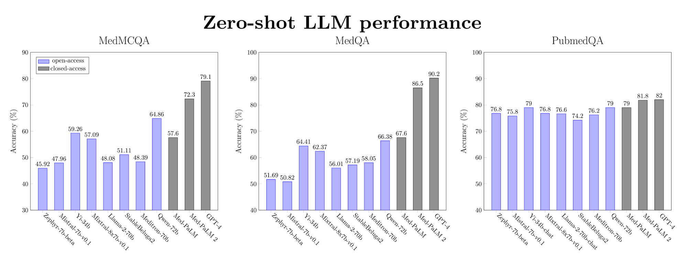
Zero-shot performance for a selected subset of LLMs (ranked by model size) on medical QA datasets

Slide 28
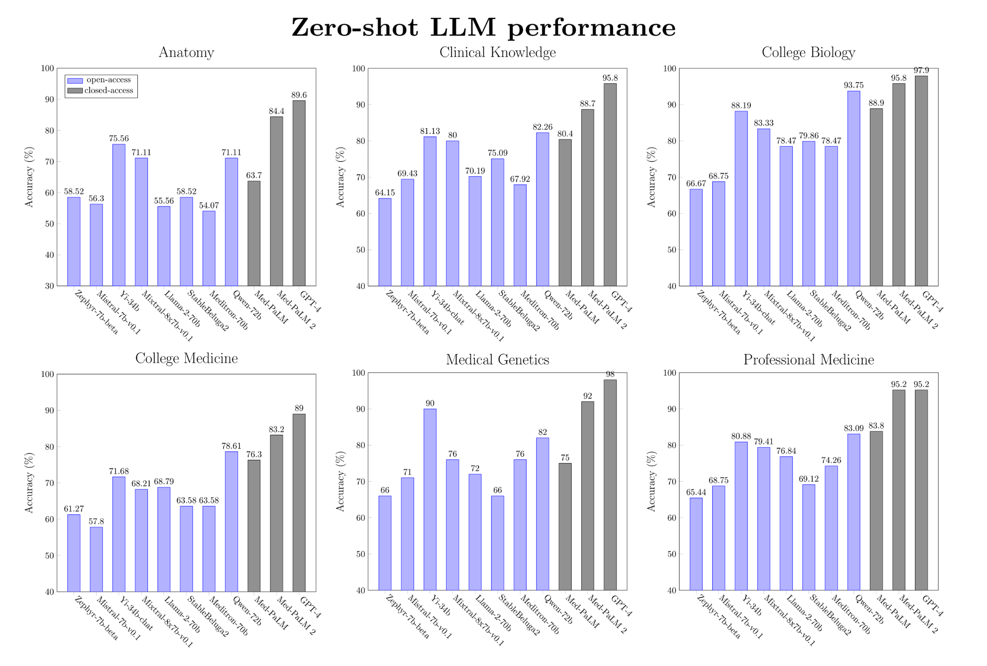
Zero-shot performance for a selected subset of LLMs (ranked by model size) on medical MMLU tasks

Slide 29
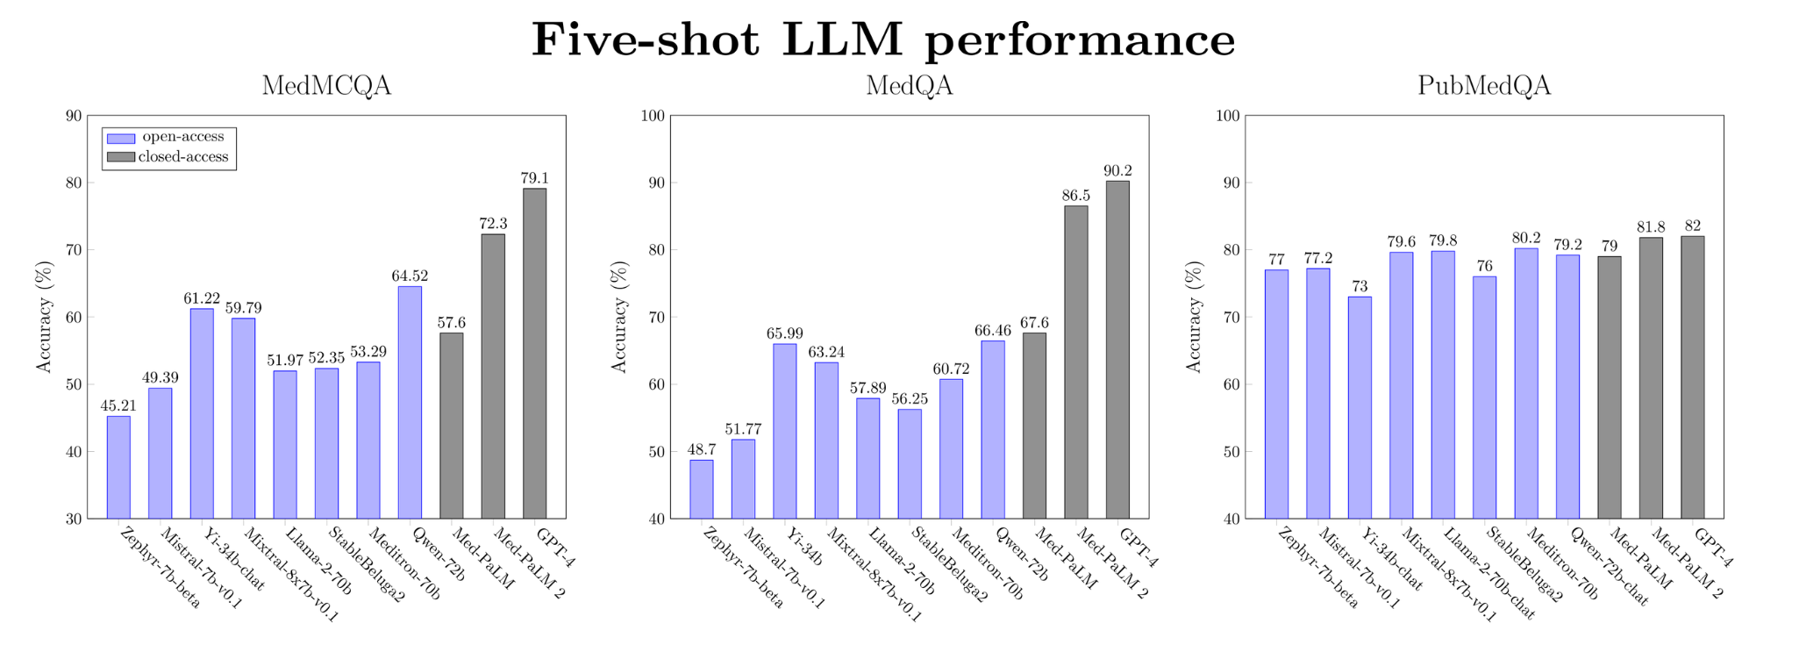
Five-shot performance for a selected subset of LLMs (ranked by model size) on medical QA datasets

Slide 30
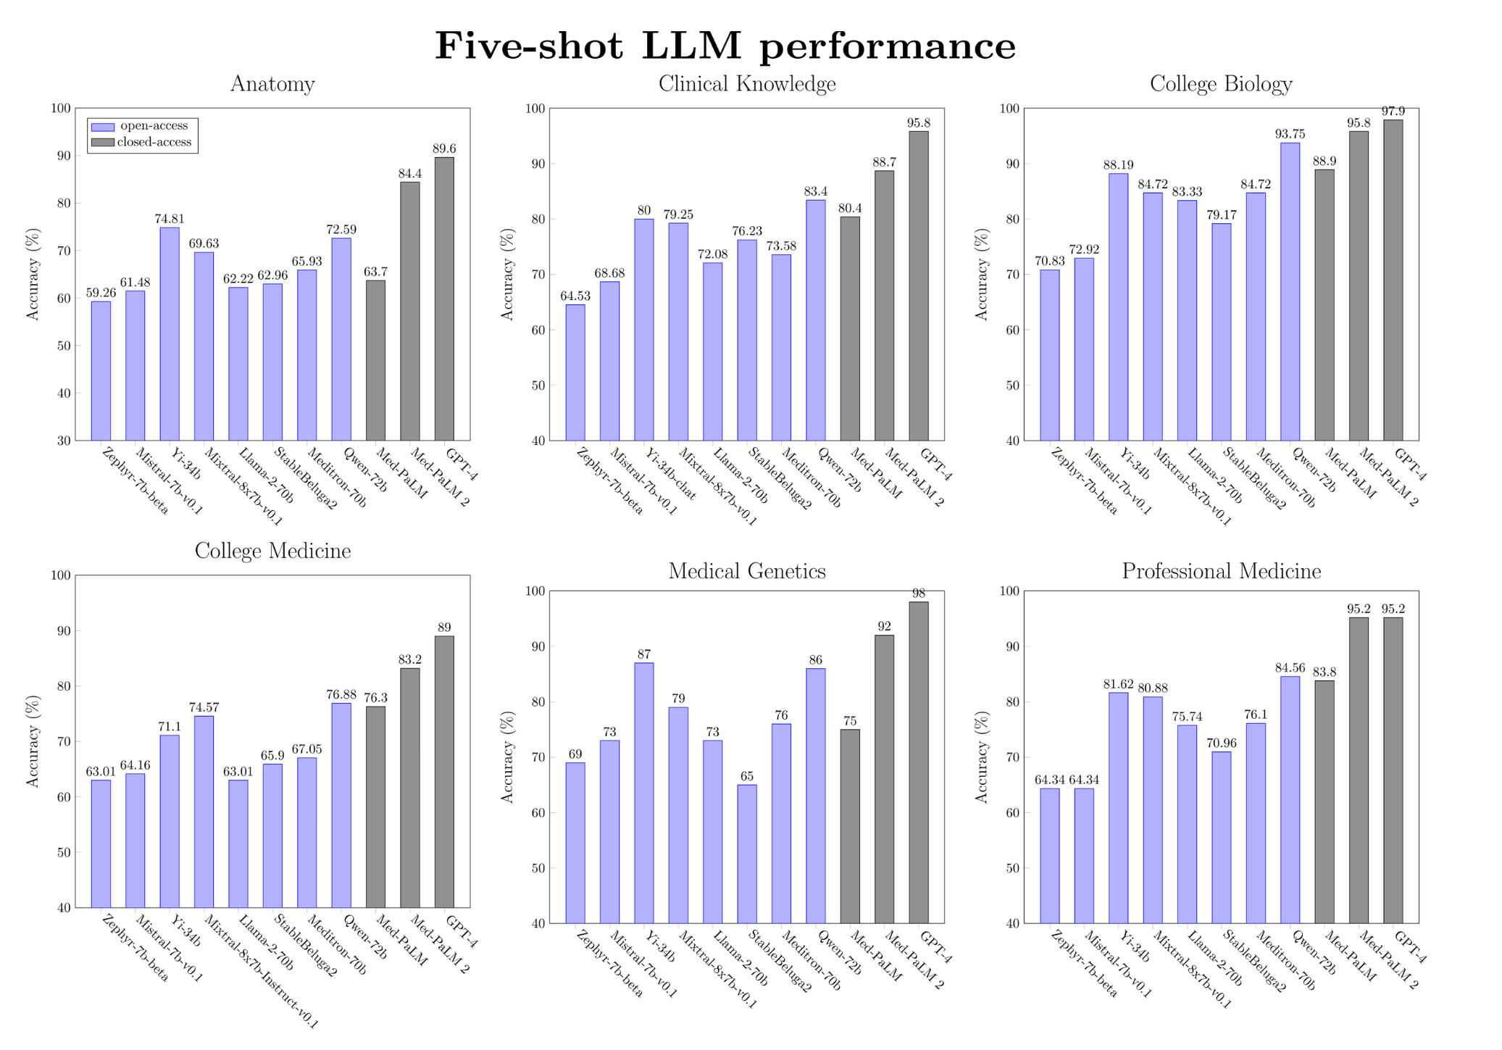
Five-shot performance for a selected subset of LLMs (ranked by model size) on medical MMLU tasks

Slide 31
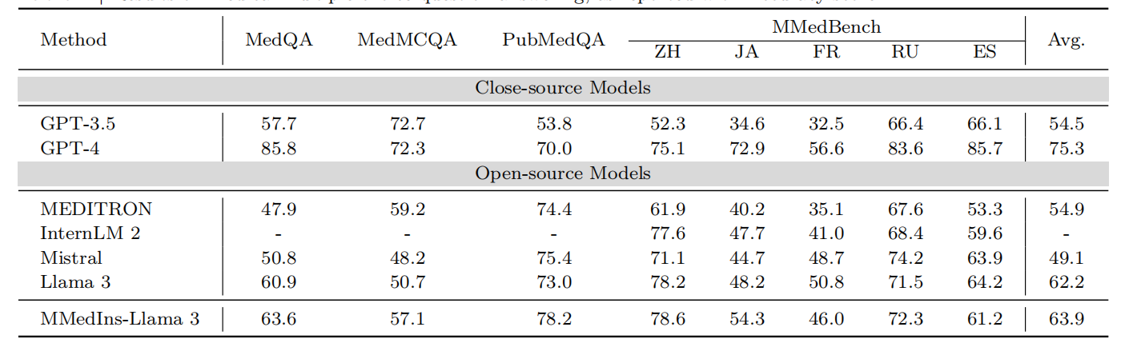
Towards Evaluating and Building Versatile Large Language Models for Medicine
Results on medical multiple-choice question answering, as reported with Accuracy score

Slide 32
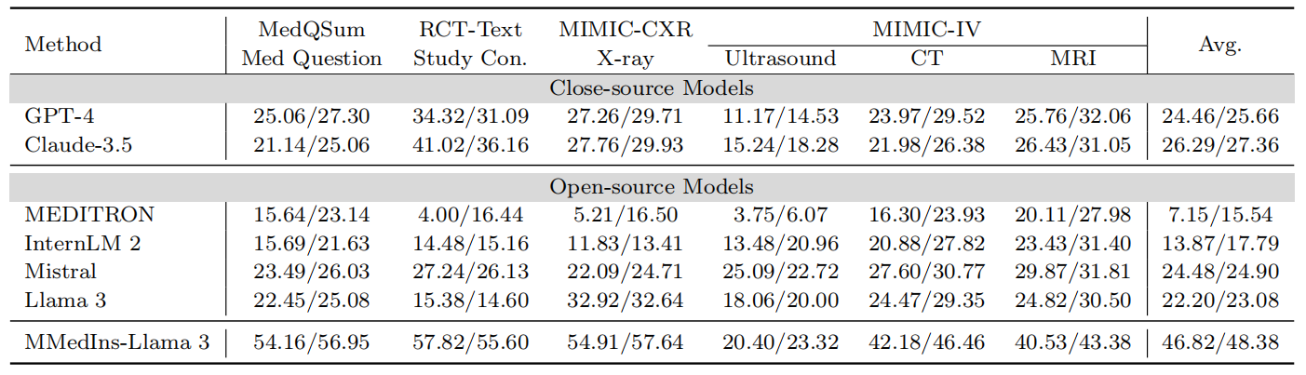
Results on text summarization, as reported with BLEU and ROUGE scores, formatted as ‘BLEU/ROUGE’. “Con.” denotes conclusions

Slide 33
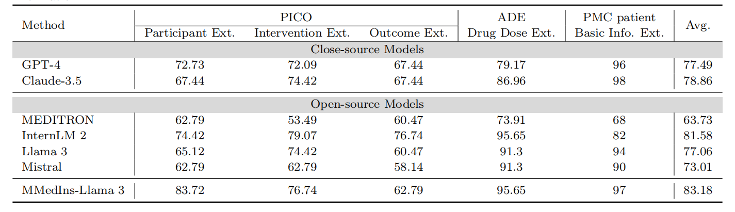
Results on information extraction, as reported with Accuracy score. “Ext.” denotes extraction and “Info.” denotes information.

Slide 34
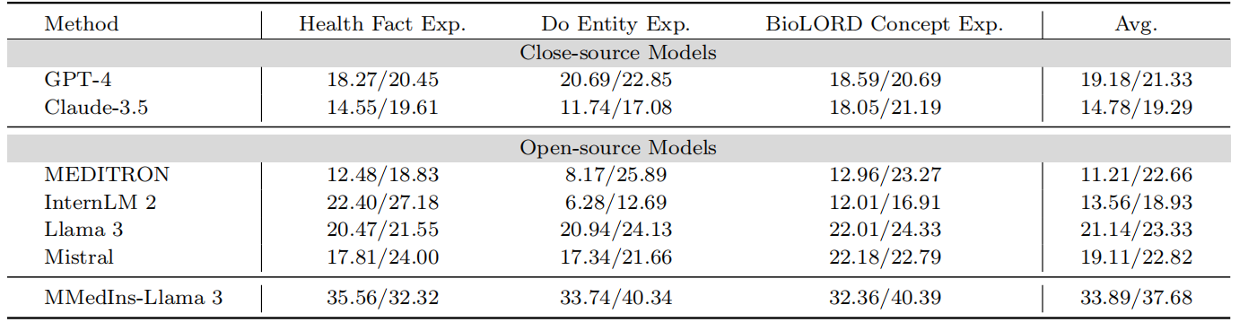
Results on medical concept explanation, as reported with ‘BLEU/ROUGE’ scores. “Exp.” denotes Explanation

Slide 35
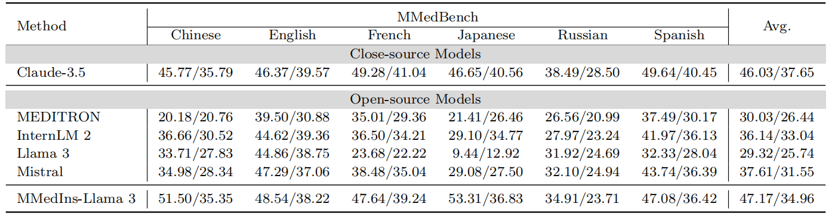
Results on rationale, as reported with ‘BLEU/ROUGE’ scores. Note here, we do not include the results for GPT-4 since the original evaluation sets were generated with it, that may bring unfair comparison bias.

Slide 36
Thanks！

